Slide 1
Geo-Distribution for Orleans
Phil Bernstein, Sebastian Burckhardt, Sergey Bykov, Natacha Crooks, José Faleiro, Gabriel Kliot, Alok Kumbhare, Vivek Shah, Adriana Szekeres, Jorgen Thelin
October 23, 2015

Slide 2
Goals for the meeting
Explain the four main components of the proposed architecture
Solicit feedback on user requirements and design ideas
Connect with early adopters
Multi-Cluster Configuration
Queued Grains
Global Single-Instance Grains
Replication Providers

Slide 3
Why Geo-Distribution?
Better Service Latency
use datacenter close to client for servicing that client
Better Fault Tolerance
application is available despite datacenter failure

Slide 4
Design Challenges / Proposed Components
Administration and Configuration
How to connect multiple clusters?
How to add/remove clusters on-the-fly?
Choose & Implement a Programming Model
Independent grain directories?
One grain instance globally?
Multiple grain copies that synchronize?
Multi-Cluster Configuration
(default)
Global Single-Instance Grains
Queued Grains
Replication Providers

Slide 5
Talk Outline & Component Dependencies
1
Multi-Cluster Configuration
3
Queued Grains
2
Global Single-Instance Grains
4
Replication Providers

Slide 6
Part 1:
Multi-Cluster Configuration

Slide 7
Multi-Cluster
Multi-Cluster Configuration
C
A
B
Orleans manages each cluster as usual
But now, there can be more than one such cluster.

Slide 8
Physical Network
Multi-Cluster Configuration
C
A
B
We assume that all nodes can connect via TCP
This may require some networking configuration (outside scope of Orleans)

Slide 9
Azure Multi-Cluster Example
Multi-Cluster Configuration
Europe
(Production)
Europe
(Staging)
US-West
VNET
A
B
C
VNET
VNET
GATEWAY
Storage
Storage

Slide 10
Discovery, Routing, Administration ?
Multi-Cluster Configuration
B
A
C
Channel 1
Channel 2
To share routing and configuration information, connect clusters by two or more gossip channels
No single point of failure
Currently, each gossip channel is an Azure table

Slide 11
Example: Configuration
Multi-Cluster Configuration
On Cluster A:
On Cluster B:
On Cluster C:
<MultiClusterNetwork GlobalServiceId="MyService" ClusterId="A">
<GossipChannel Type="AzureTable" ConnectionString=“Channel_1" />
<GossipChannel Type="AzureTable" ConnectionString=“Channel_2" />
</MultiClusterNetwork>
<MultiClusterNetwork GlobalServiceId="MyService" ClusterId=“B">
<GossipChannel Type="AzureTable" ConnectionString=“Channel_1" />
<GossipChannel Type="AzureTable" ConnectionString=“Channel_2" />
</MultiClusterNetwork>
<MultiClusterNetwork GlobalServiceId="MyService" ClusterId=“C">
<GossipChannel Type="AzureTable" ConnectionString=“Channel_1" />
<GossipChannel Type="AzureTable" ConnectionString=“Channel_2" />
</MultiClusterNetwork>

Slide 12
Connected ≠ Joined
Multi-Cluster Configuration
Connecting to the multi-cluster network does not mean a cluster is part of the active configuration yet.
Active configuration
is controlled by administrator
carries a timestamp and a comment
never changes on its own (i.e. is completely independent of what nodes are connected, working, or down)

Slide 13
Changing active configuration
Multi-Cluster Configuration
Administrator injects timestamped configuration on any cluster
Automatically spreads through gossip channels
var systemManagement = GrainClient.GrainFactory.GetGrain<IManagementGrain>(
RuntimeInterfaceConstants.SYSTEM_MANAGEMENT_ID);
systemManagement.InjectMultiClusterConfiguration(
new Orleans.MultiCluster.MultiClusterConfiguration(
DateTime.UtcNow,
"A,B,C",
"I am now adding cluster C"
));

Slide 14
Part 2:
Global Single-Instance Grains

Slide 15
Global Single-Instance Grains
[GlobalSingleInstance]
public class MyGrain : Orleans.Grain, IMyGrain
{
...
}
Grains marked as single-instance are kept in a separate directory that is coordinated globally
Calls to the grain are routed to
the cluster containing the current activation (if it exists)
a new activation in the caller’s cluster (otherwise)

Slide 16
Typical indications for using a global-single-instance grain
Global Single-Instance Grains
The vast majority of accesses to the grain are in one cluster.
But the grain needs to be instantiable in different clusters at different times, e.g., due to:
Changing access patterns
Cluster failure

Slide 17
Example: A Game Grain
Global Single-Instance Grains
Single-Instance Game Grain
Silo
Silo
Silo
Silo
Silo
Silo
Frontend
Frontend
DC1
DC2
Clients
Clients

Slide 18
Example: A Game Grain
Global Single-Instance Grains
New Single-Instance Game Grain
Silo
Silo
Silo
Silo
Silo
Silo
Frontend
Frontend
DC1
DC2
Clients
Clients

Slide 19
Guarantees
Global Single-Instance Grains
If cross-cluster communication is functional, at most one activation globally.
If cross-cluster communication is broken, there may be multiple activations temporarily
Duplicate instances are automatically deactivated once communication is restored
Same as for regular single-cluster grains today!

Slide 20
Part 3:
Queued Grains

Slide 21
Concerning Performance...
Queued Grains
Global coordination is relatively slow and not always needed.
often o.k. to read cached state instead of latest
often o.k. to update state asynchronously
Idea: improve read/write performance by means of an API that supports Caching and Queueing.

Slide 22
Queued Grains
One Local state cached per cluster
One Global state somewhere (e.g. storage)
States remain automatically synchronized
B
A
C

Slide 23
Queued Grains
Grain<T>
QueuedGrain<T>
State
ReadStateAsync
WriteStateAsync
ClearStateAsync
(new API)
(new API)
Cache + Queue
Cache + Queue
State
Storage
Storage
23

Slide 24
Queued Grains
TGrainState ConfirmedState { get; }
void EnqueueUpdate(IUpdateOperation<TGrainState> update);
IEnumerable<IUpdateOperation<TGrainState>> UnconfirmedUpdates { get; }
TGrainState TentativeState { get; }
public interface IUpdateOperation<TGrainState>
{
void Update(TGrainState state);
}
Confirmed State
Update
Update
Local
Update
Tentative State

Slide 25
Automatic Propagation: Local -> Global
Queued Grains
background process applies queued updates to global state
keep retrying on failures (e.g. e-tag, offline)
updates applied in order, no duplication
Confirmed State
Update
Update
Local
Update
Tentative State
Network
Global
State
Actual State
Remote

Slide 26
Automatic Propagation: Global -> Local
Queued Grains
all changes to global state are pushed to confirmed state
updates are removed from queue when confirmed
Confirmed State
Update
Update
Local
Update
Tentative State
Network
Global
State
Actual State
Remote

Slide 27
How to make a queued grain
Queued Grains
Define the grain interface (as usual)
Define the grain state (as usual)
For each update operation, define a new class that describes the update (as for ES)
Write the grain implementation

Slide 28
Example: Chat Application
Queued Grains
Users connect to a chat room (one grain = one chat room)
Users enter chat messages
Chat room displays last 100 messages

Slide 29
Example: Chat Grain Interface + State
Queued Grains
public interface IChatGrain : IGrain
{
Task<IReadOnlyList<string>> GetMessages();
Task AddMessage(string message);
}
[Serializable]
public class ChatState : GrainState
{
// list that stores last 100 messages
public List<string> Messages { get; set; }
public ChatState() { Message = new List<string>(); }
}

Slide 30
Example: Chat Grain Update Operation
Queued Grains
[Serializable]
public class MessageAddedEvent: IUpdateOperation<ChatState>
{
public string Content { get; set; }
public void Update(ChatState state)
{
state.Messages.Add(Content);
// remove oldest message if necessary
if (state.Messages.Count > 100)
Messages.RemoveAt(0);
}
}

Slide 31
Example: Chat Grain Implementation
Queued Grains
public class ChatGrain : QueuedGrain<ChatState>, IChatGrain
{
public Task<IReadOnlyList<string>> GetMessages()
{
return Task.FromResult(this.TentativeState.Messages);
}
public Task AddMessage(string message)
{
EnqueueUpdate(new MessageAddedEvent()
{ Content = message } );
return TaskDone.Done;
}
}

Slide 32


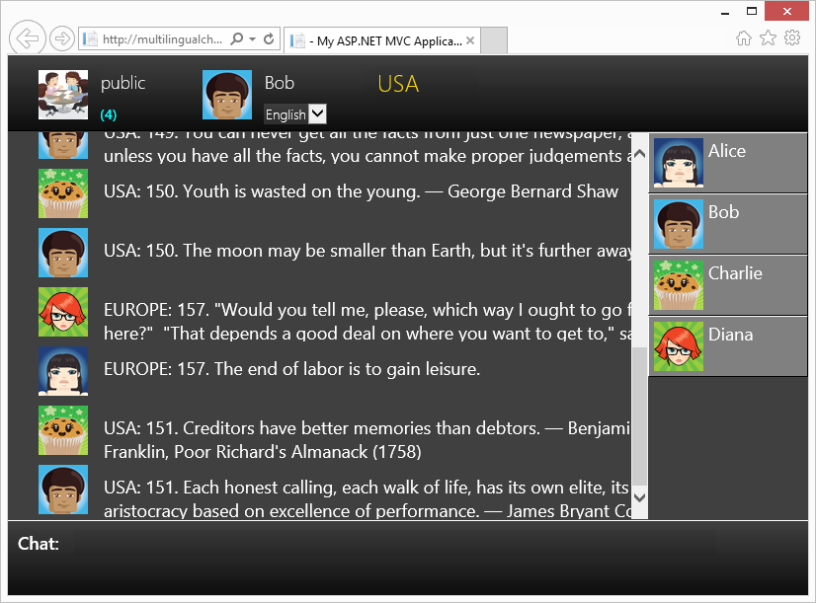
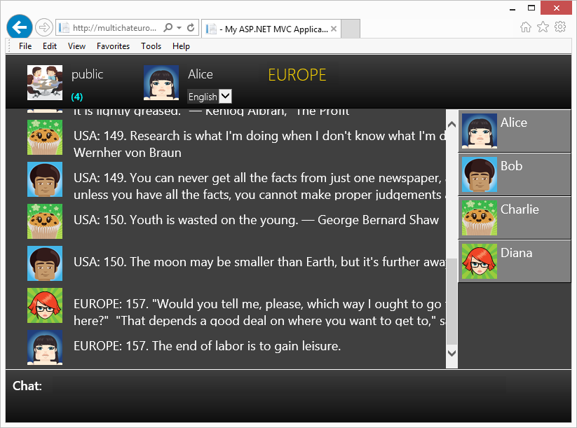
Chat Room – Normal Operation
Queued Grains
Datacenter
US
Datacenter
Europe
Chat Room Object
Queues drain quickly, copies stay in sync

Slide 33
Failure Scenario : (1) Storage Offline
Queued Grains
Datacenter
US
Datacenter
Europe
Chat Room Object
Queues accumulate unconfirmed updates
Users can see only messages from same datacenter

Slide 34
Failure Scenario : (2) Storage Is Back
Queued Grains
Datacenter
US
Datacenter
Europe
Chat Room Object
Queues drain, messages get ordered consistently, normal operation resumes

Slide 35
Beyond geo-distribution...
Queued Grains
Queued Grain helps to mitigate slow storage even in single cluster
Queued Grain is a good match for the event-sourcing pattern

Slide 36
Part 4:
Replication Providers

Slide 37
Under the Hood: Global State = Illusion
Replication Providers
Replica
in RAM
Replica
in RAM
Replica
in RAM
Replica
in RAM
Many possible configurations, to support variable degrees of
persistence
fault tolerance
reactivity
Same programming API for all.
Shared Storage
Replica
in RAM
Replica
in RAM
Storage
Replica
Storage Replica

Slide 38
Status & Next Steps
All code, including samples and benchmarks, is currently in a internal VSO repository
Estimate 1-3 months to pull all pieces into GitHub and have them reviewed by community, in order of dependencies
Documents available by Monday:
Research paper draft
Documentation for developers
Multi-Cluster Configuration
Queued Grains
Global Single-Instance Grains
Replication Providers

Slide 40
BACKUP SLIDES

Slide 41
Orleans Today
Programmer defines grains (virtual actors)
Configuration defines cluster of silos
Runtime manages grains (directory, load, communication, silo failures)
Cluster
Grains
Silo

Slide 42
Single-Activation Design
A request to activate grain G in cluster C runs a protocol to get agreement from all other clusters that C owns G.
First, optimistically activate the grain
Most accesses of G are in C, so a race where C′ is concurrently activating G is rare.
Allow duplicate activations when there’s a partition
Prioritize availability over consistency
Anti-entropy protocol to resolve duplicate activations
One activation is killed. Its application-specific logic in the Deactivate function merges state, as appropriate
Notes:
Based on this feedback we made three design decisions:
First, we optimistically activate a grain before we run the geo-distributed protocol.
Second, we allow duplicate activations in the presence of partitions.
Thid, we added an anti-entropy phase to our protocol in order to quickly detect and resolve duplicate activations.

Slide 43
Cross-Cluster Single-Activation Protocol
Cluster C receives a local activation request for grain G. If G is referenced in C’s grain directory, then return the reference.
Else activate G in C and tell every other cluster C′ that C requests ownership.
C′ replies “I own G” or it stores “C might own G” and replies “I don’t own G”
If all C′ reply “I don’t own G”, then C stores “I own G” and lazily replies “I own G” to other clusters, which change “C might own G” to “C owns G”
If C′ replies “I own G”, then a reconciliation oracle decides who wins.
The losing cluster’s Deactivate function merges or discards its state, as appropriate
Else, C’s ownership is in doubt until all clusters reply.

Slide 44
Replicated Grain
Programmer chooses availability/consistency.
For updates (mutating methods), choose
I want to wait for the update to globally propagate, or
just do it in the background
For reads (non-mutating methods), choose
I need the latest state, or
an approximate state is o.k.

Slide 45
Chat Room Example
User1: Append(m1), Append(m2)
User2: Append(m3), Append(m4)
The global sequence is any shuffle of the user-local sequences. Possible global orders:
S1= A(m1) A(m2) A(m3) A(m4)
S2= A(m1) A(m3) A(m2) A(m4)
S3= A(m1) A(m3) A(m4) A(m2)
S4= A(m3) A(m4) A(m1) A(m2)
S5= A(m3) A(m1) A(m4) A(m2)
S6= A(m3) A(m1) A(m2) A(m4)

Slide 46
Chat Room Example
User1: Append(m1), Append(m2)
User2: Append(m3), Append(m4)
Gossiping Protocol
U1 executes A(m1)
U1 sends A(m1) to U2
U1 executes A(m2)
U2 executes A(m3) and sends [A(m1), A(m3)] to U1
U1 must merge [A(m1), A(m2)] and [A(m1), A(m3)]
m1 = a question
m2 = follow-on question
m3 = explanation that
covers both questions

Slide 47
Chat Room Example
User1: Append(m1), Append(m2)
User2: Append(m3), Append(m4)
Local/Global Protocol
U1 executes A(m1)
U1 sends A(m1) to Global
Global returns [A(m1)] to U1
U1 executes A(m2)
U1 sends A(m2) to Global
U2 executes A(m3)
U2 sends A(m3) to Global
Global returns [A(m1), A(m2), A(m3)] to U1
m1 = a question
m2 = follow-on question
m3 = explanation that
covers both
questions

Slide 48
Example: Chat Application
Users connect to a chat room
Users enter chat messages
Chat room displays messages in order
The chat room object is instantiated in two datacenters.
Chat room state = set of connected users and sequence of recent messages
Each user interacts with its datacenter-local chat room object
Chat room program updates state using updateLocal
Updates propagate to storage in the background
No app code to handle failures or recoveries of storage or data centers

